Slide 1




Corona Virus Analysis
Using SQL
-Pooja Preethi Mugan M

Slide 2
Introduction
Problem Statement
Dataset Description
Data Exploration using SQL
Summary
Key Insights
Topics

Slide 3

Introduction
Overview of COVID-19:
The coronavirus pandemic, caused by the SARS-CoV-2 virus, emerged in late 2019 and rapidly spread worldwide.
The pandemic has had significant health, economic, and social impacts globally.
Objective of the Analysis:
To analyse the spread, impact, and trends of COVID-19 based on confirmed cases, deaths, and recoveries using available data.

Slide 4
Problem Statement
Key Questions:
How did COVID-19 spread over time across different regions?
What are the monthly trends in confirmed cases, deaths, and recoveries?
Which country had the highest number of confirmed cases?
Which country had the lowest number of death cases?
Which countries had the highest number of recoveries?

Slide 5
Dataset Description:
Province: Geographic subdivision within a country/region.
Country/Region: Geographic entity where data is recorded.
Latitude & Longitude: Coordinates indicating the location.
Date: Recorded date of COVID-19 data.
Confirmed: Number of diagnosed COVID-19 cases.
Deaths: Number of COVID-19 related deaths.
Recovered: Number of recovered COVID-19 cases.

Slide 6
Data
Exploration
Using SQL

Slide 7
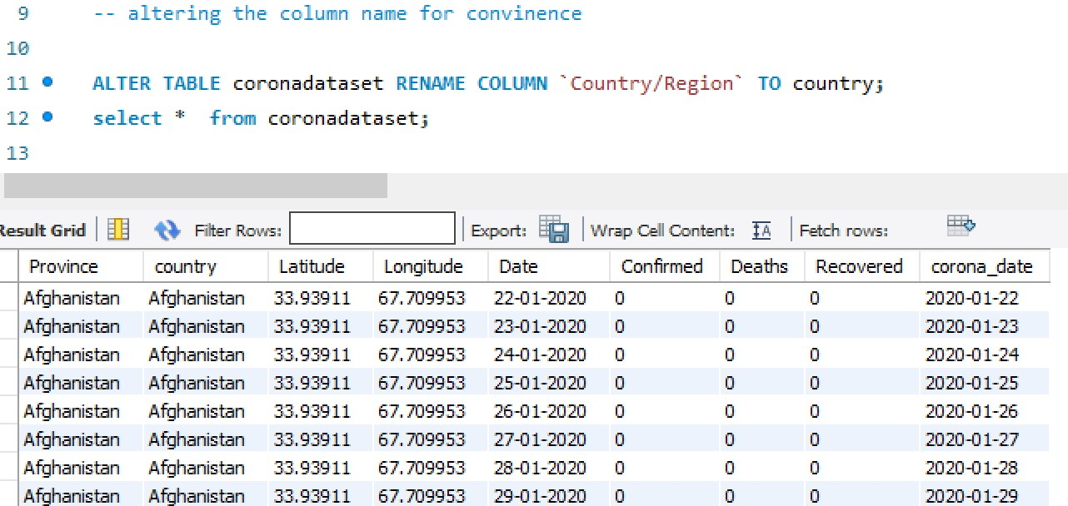
Altering table

Slide 8
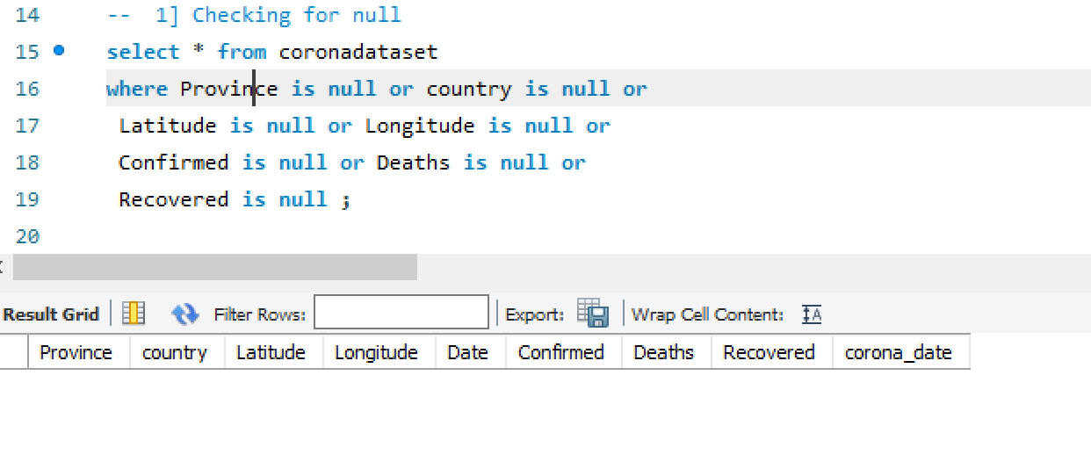
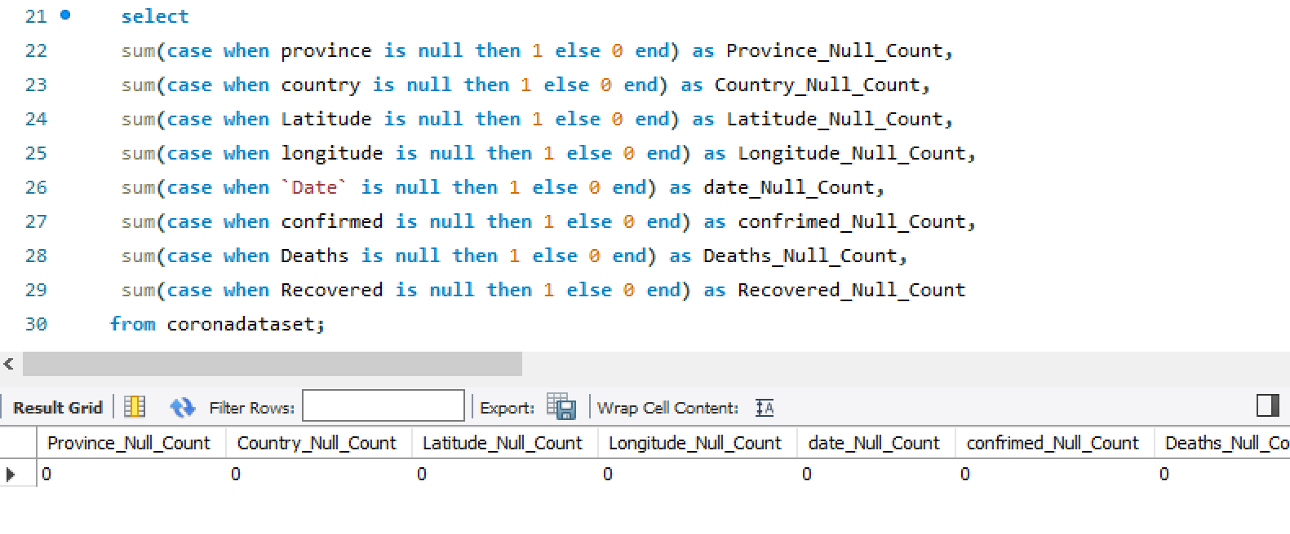
Checking for NULL Values

Slide 9
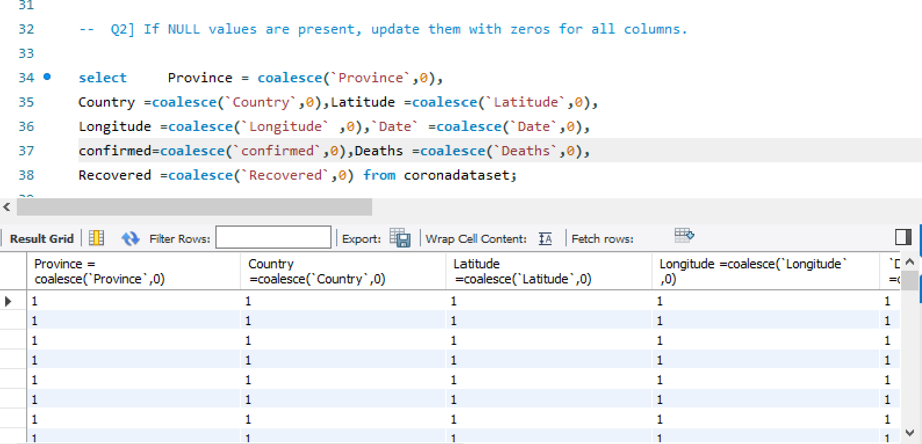
Updating NULL Values

Slide 10
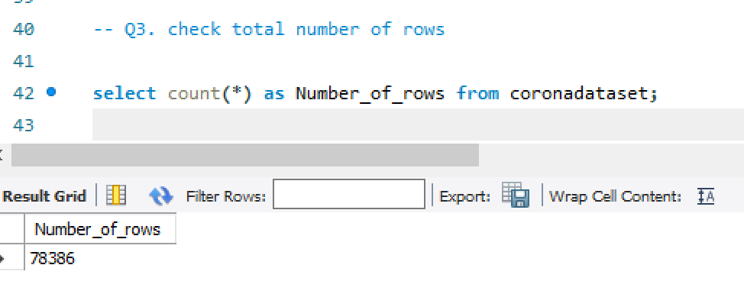
Total Number of Rows

Slide 11
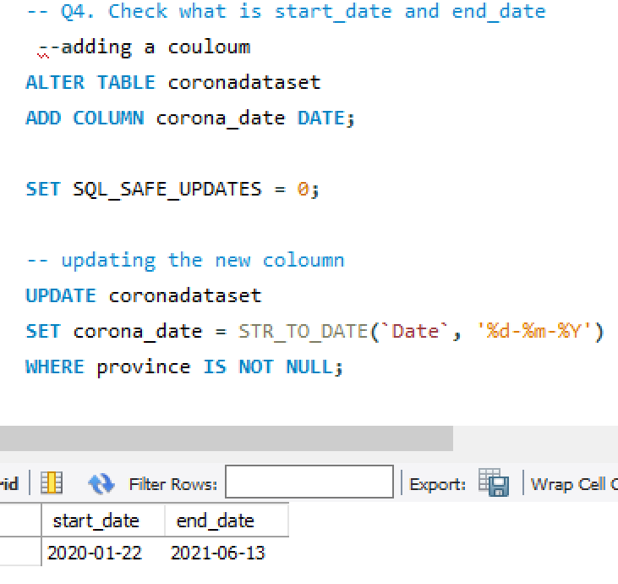
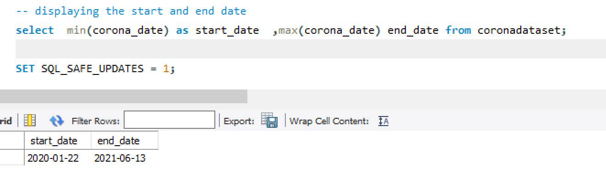
Date Range

Slide 12
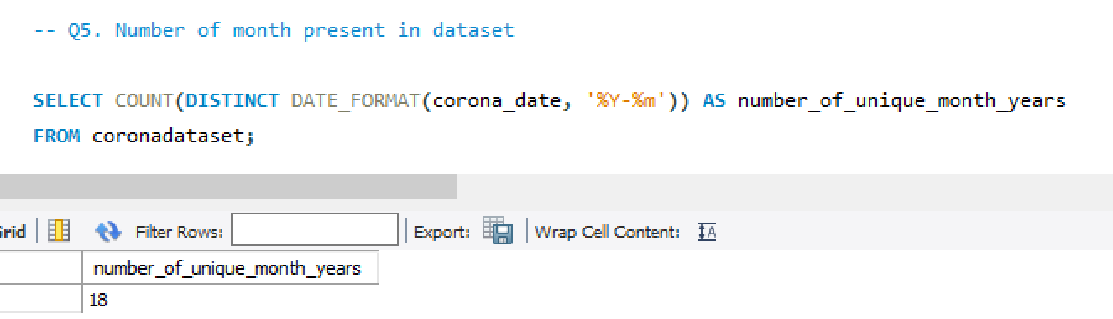
Number of Months in Dataset

Slide 13
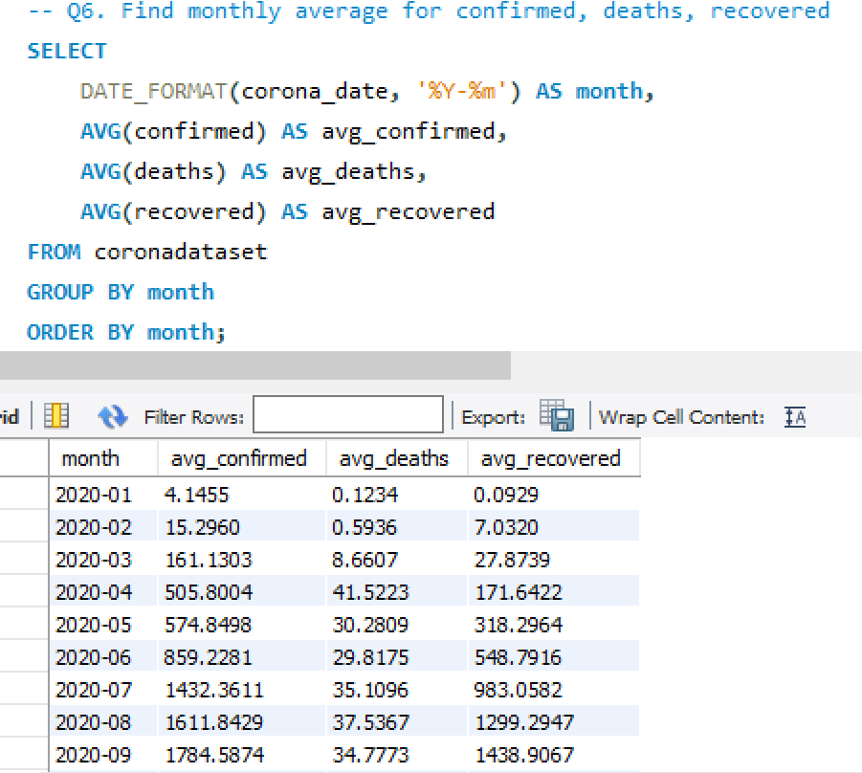
Monthly Average for Confirmed, Deaths, and Recovered

Slide 14
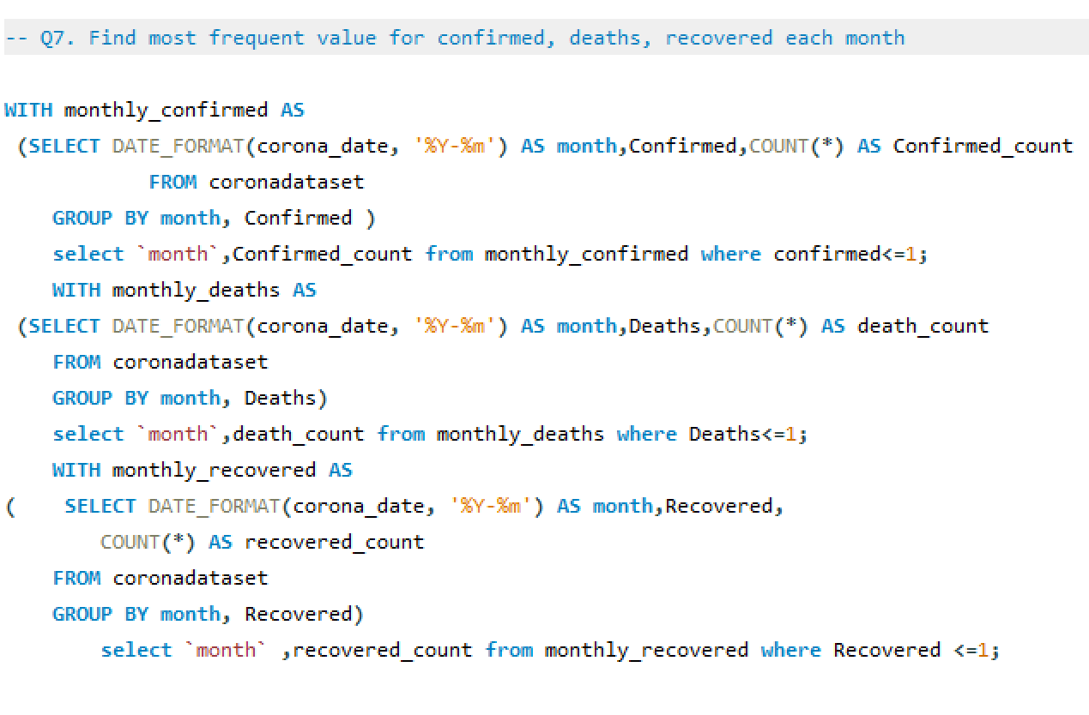
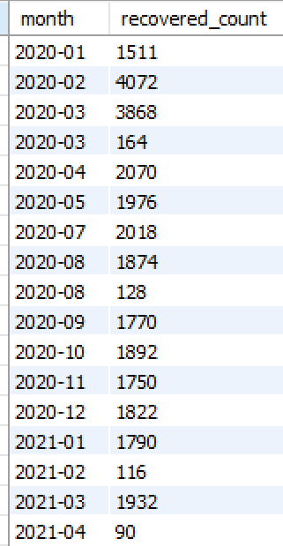
Most Frequent Values Per Month

Slide 15
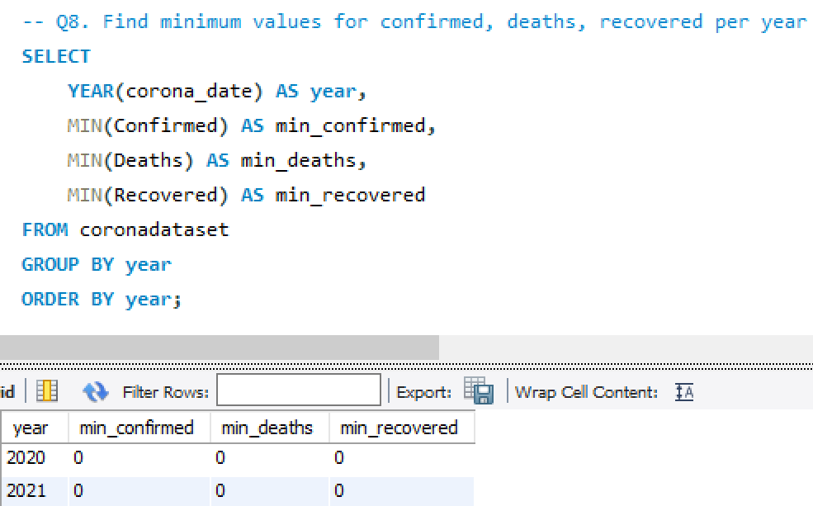
Minimum Values Per Year

Slide 16
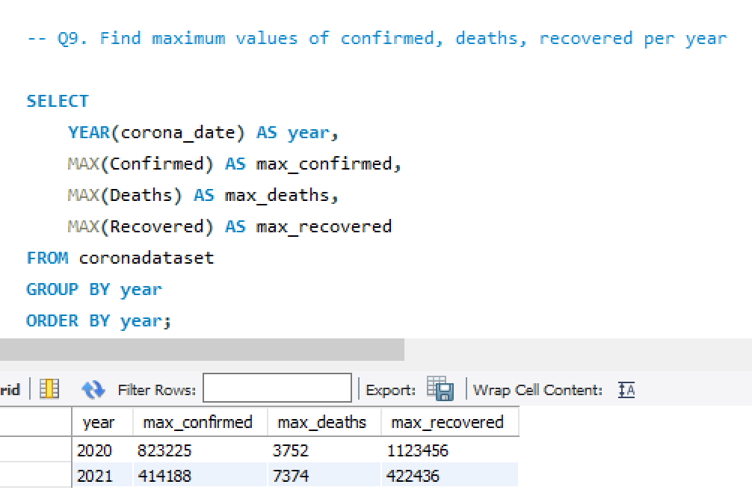
Maximum Values Per Year

Slide 17
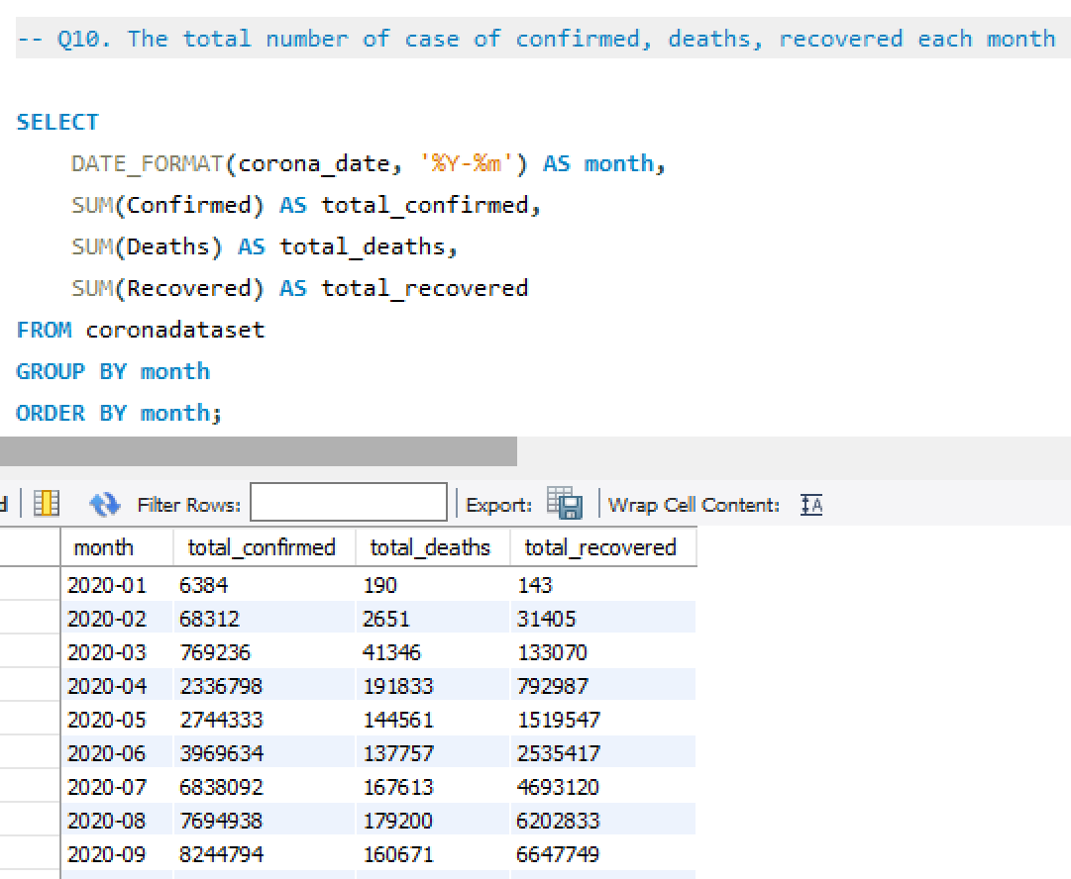
Total Cases Per Month

Slide 18
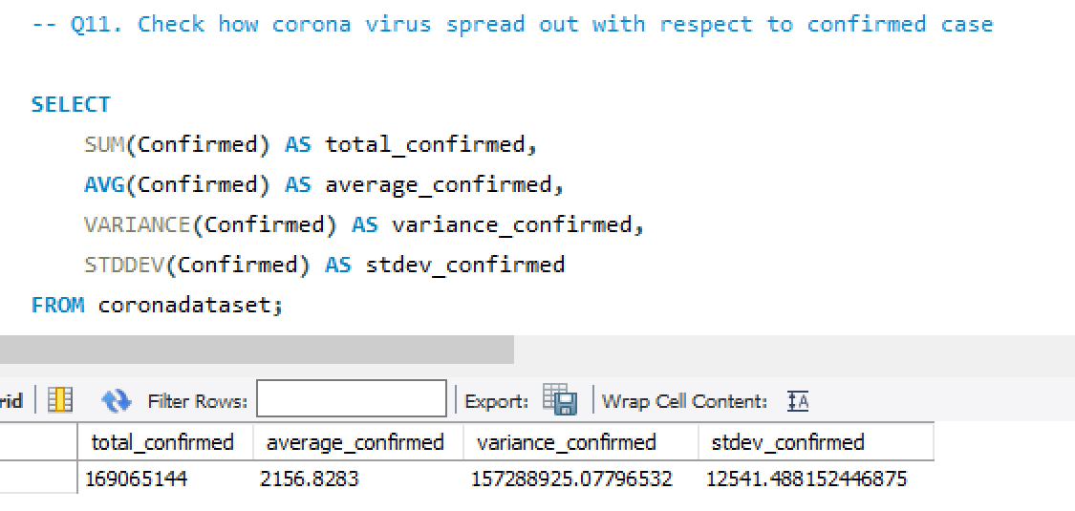
Spread Analysis for Confirmed Cases

Slide 19
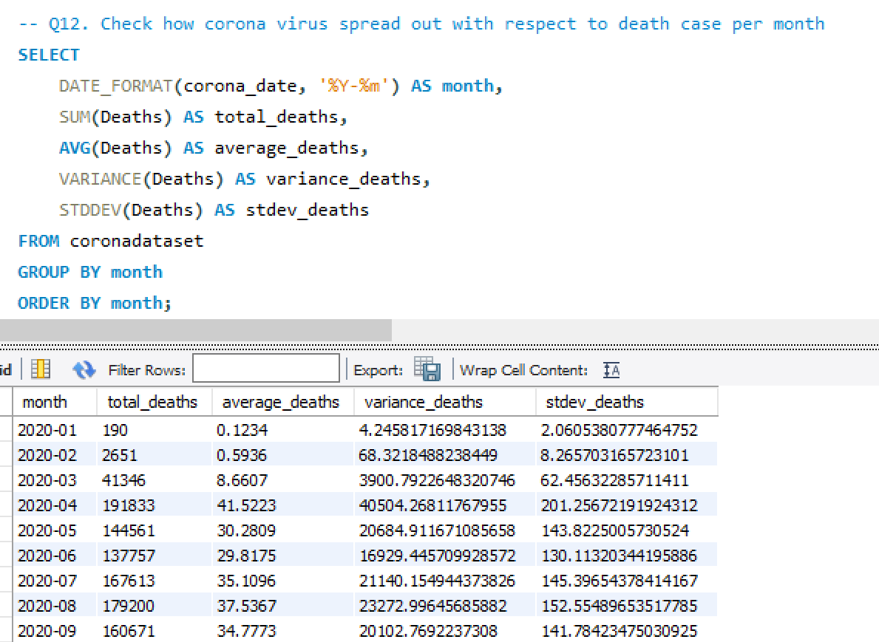
Spread Analysis for Deaths Per Month

Slide 20
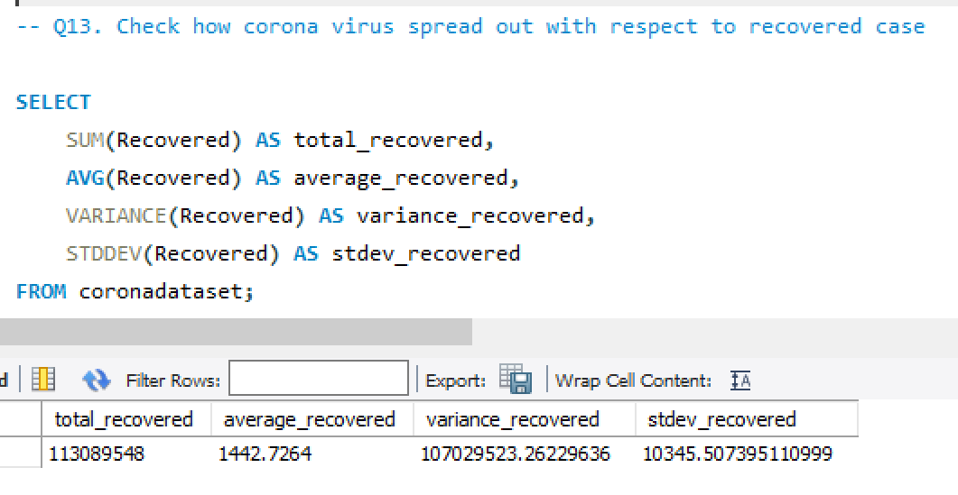
Spread Analysis for Recovered Cases

Slide 21
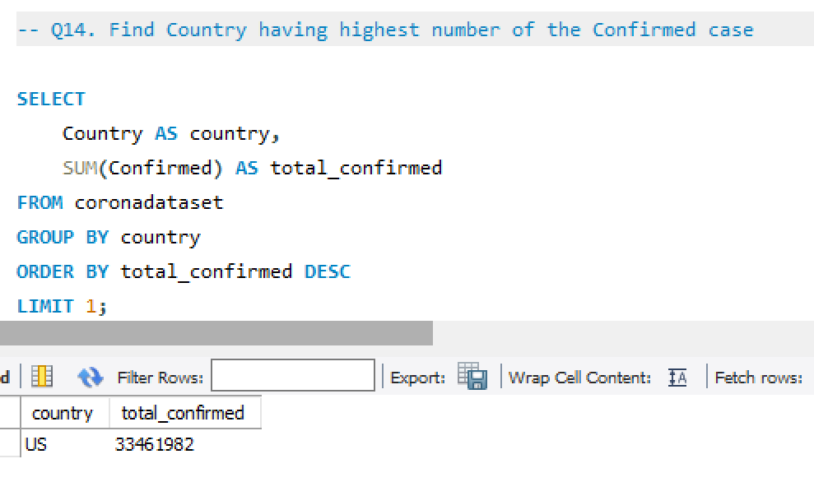
Country with Highest Confirmed Cases

Slide 22
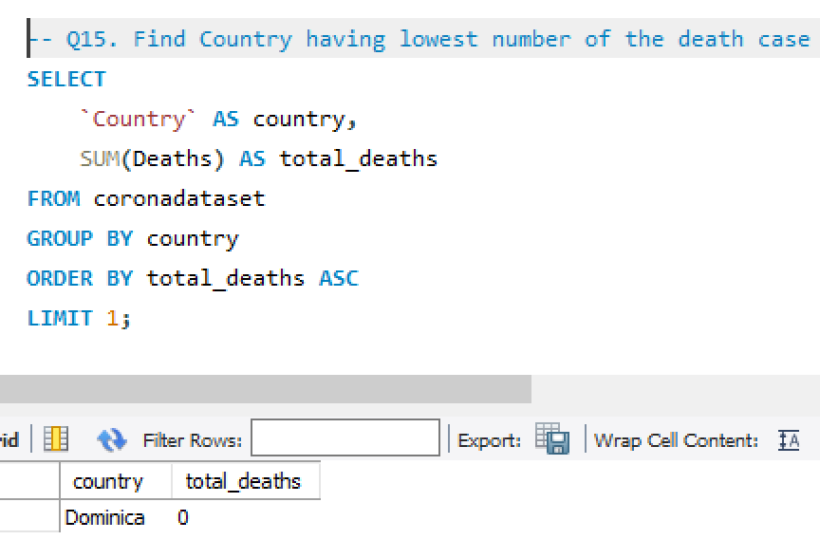
Country with Lowest Death Cases

Slide 23
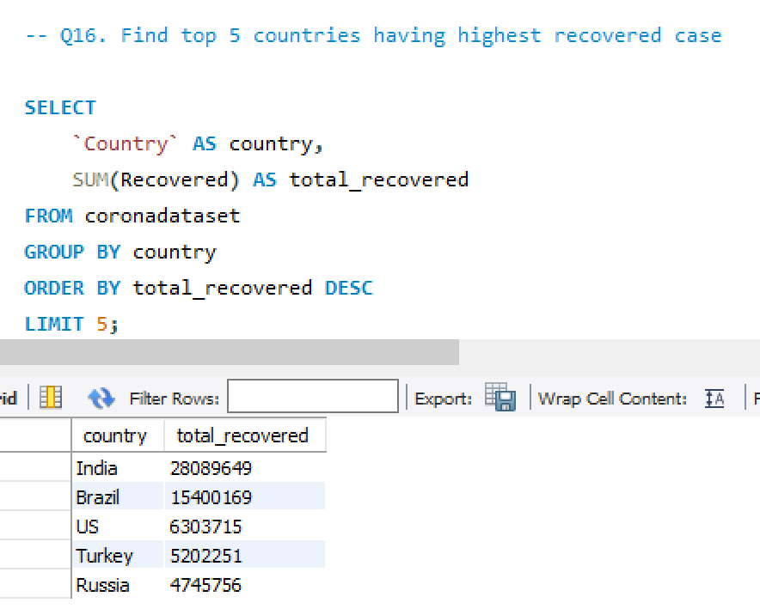
Top 5 Countries with Highest Recovered Cases

Slide 24
Key Insights
Data Coverage:
Spans over two years, providing a comprehensive view of the pandemic.
Monthly Trends:
Significant variations in confirmed cases, deaths, and recoveries.
Spread of the Virus:
Rapid initial increases followed by control and resurgence phases.
Country-Specific Insights:
Top 5 countries with the highest recoveries show effective management.
Identified countries with the highest confirmed cases and the lowest death cases.
Statistical Analysis:
Variance and standard deviation indicate fluctuations in the pandemic's impact.

Slide 25


-Pooja Preethi Mugan M
Maili: mppm167@gmail.com
LinkedIn: www.linkedin.com/in/pooja-preethi-mugan-9930a9180

